Slide 1
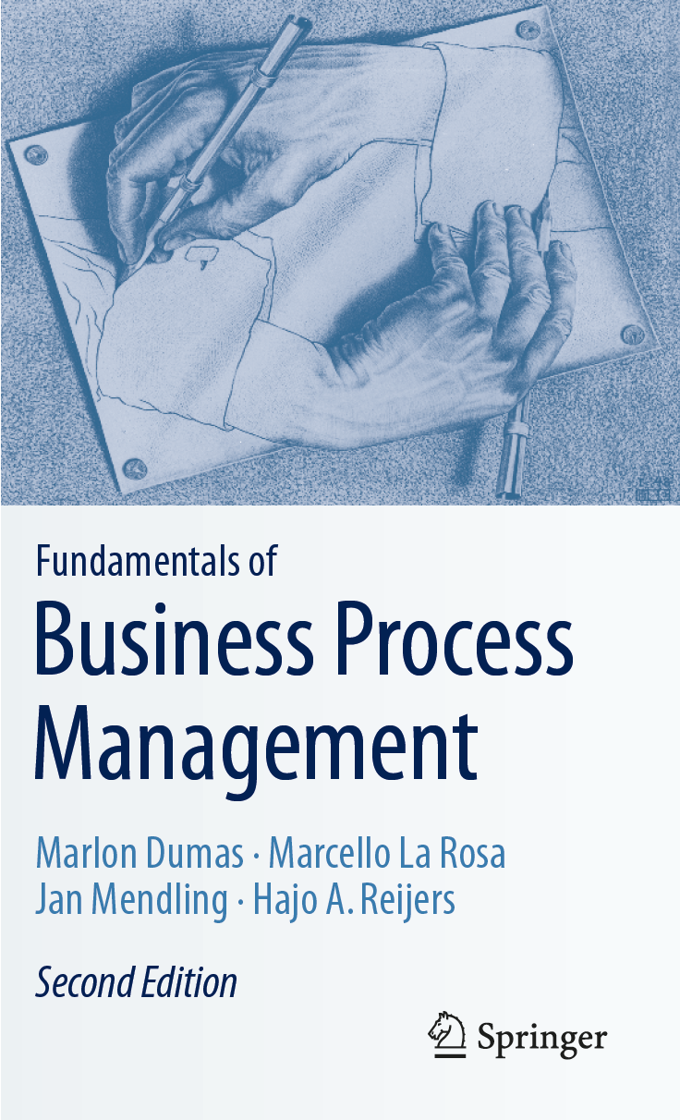
Chapter 9: Process-Aware Information Systems
Contents
Types of Process-Aware Information Systems
Domain-Specific Process-Aware Information Systems
Business Process Management Systems
Architecture of a BPMS
The Case of ACNS
Advantages of Introducing a BPMS
Workload Reduction
Flexible System Integration
Execution Transparency
Rule Enforcement
Challenges of Introducing a BPMS
Technical Challenges
Organizational Challenges
Recap

Slide 2

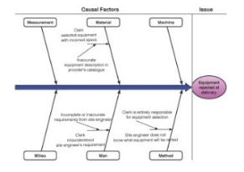
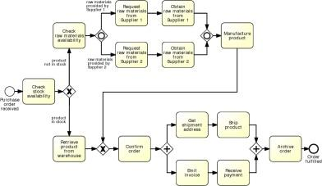

Process-Aware Information Systems in the BPM Lifecycle

Slide 3
Chapter Overview
This chapter deals with information systems that support process automation.
We explain what an automated business process is, after which we focus on a specific kind of technology that is suitable to achieve process automation:
Process-Aware Information Systems (PAISs) and
Business Process Management Systems (BPMSs).
We discuss some of the
Advantages and
Challenges
that are involved with introducing a BPMS in an organization..

Slide 4
Chapter 9: Process-Aware Information Systems
Contents
Types of Process-Aware Information Systems
Domain-Specific Process-Aware Information Systems
Business Process Management Systems
Architecture of a BPMS
The Case of ACNS
Advantages of Introducing a BPMS
Workload Reduction
Flexible System Integration
Execution Transparency
Rule Enforcement
Challenges of Introducing a BPMS
Technical Challenges
Organizational Challenges
Recap

Slide 5
Domain-Specific Process-Aware Information Systems
Enterprise Resource Planning (ERP) systems:
Provide generic business functionality, which is required across various industries.
Supports accounting, controlling, human resource management, and production.
Most important processes covered are procure-to-pay and order-to-cash process.
Customer Relationship Management (CRM) systems:
Support marketing and sales.
Helps to document interaction with customers through various channels.
Supports sales and marketing activities related to products, pricing, distribution, and campaigning.
Most important processes supported are campaign-to-leads and lead-to-order.

Slide 6
Domain-Specific Process-Aware Information Systems
Supply Chain Management (SCM) systems:
Focus on support of logistics operations.
Support for freight and transportation, warehousing, storage and inventory.
Support electronic data interchange, tracking technologies such as Radio-Frequency Identification (RFID) and barcode scanning.
Key supply chain processes are order-to-delivery and return-to-refund.
Product Lifecycle Management (PLM) systems:
Support processes of product lifecycle from engineering perspective.
In realisation phase, manufacturing system is planned and actual products are built, assembled, and tested.
In service phase, products are sold and delivered, used, maintained, and eventually disposed of.
Important processes are idea-to-launch and different types of order processes.

Slide 7
Exercise 9.1: Process-Aware Information Systems
Exercise 9.1. The PAISs mentioned above (ERP, CRM, SCM, PLM, ECM) form a specific category in the market for enterprise software. Enterprise software covers not only PAISs, but also database systems, middleware, office software, and analytical software, which are not directly process-aware. The market for enterprise software is huge. According to a Gartner Report from 2017, it is estimated with a sales volume of almost $ 400 billion (more than e 340 billion).
Conduct an Internet search to find the Top 5 vendors of (a) enterprise software in general and (b) ERP systems specifically.

Slide 8
Business Process Management Systems
Groupware systems:
User is enabled to:
share documents and information and
directly communicate with other users.
Best known groupware system is IBM Notes.
Popular for their high operational flexibility.
Traditionally do not directly support business processes in a strict sense.
Several commercial groupware systems offer workflow extensions

Slide 9
Business Process Management Systems (cont.)
Ad hoc workflow systems:
Allow on-the-fly process definitions that can be created and modified.
Possible to adapt the process during execution. On the technical level, these systems
Private process definition for each case
Two major requirements to success:
end users are aware of the processes in which they operate.
Users have sophisticated tools and capability to model.

Slide 10
Business Process Management Systems (cont.)
Production workflow systems:
Most prominent type of BPMS.
Work is routed strictly on basis of process models.
Operational data typically handled by complementary DBMS.
Not allowed to deviate from process logic.
Two types:
Administrative BPMSs used in settings where work is performed by people;
Transaction processing BPMSs support processes that are automated.

Slide 11
Business Process Management Systems (cont.)
Case management systems:
Also adaptive case management system (ACM)
Supports processes that are neither tightly nor completely specified.
Case management system is fully aware of data belonging to case
Able to inform end users about status and history, and steps to continue with.

Slide 12
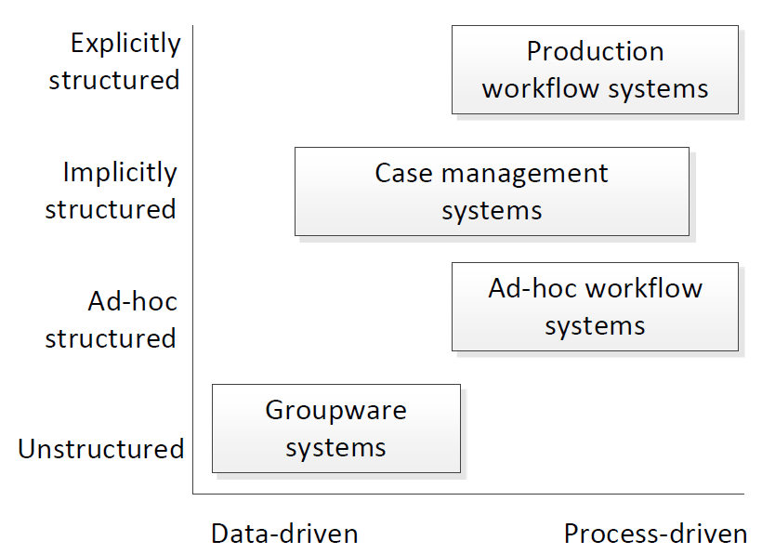
Spectrum of Business Process Management Systems (BPMS)

Slide 13
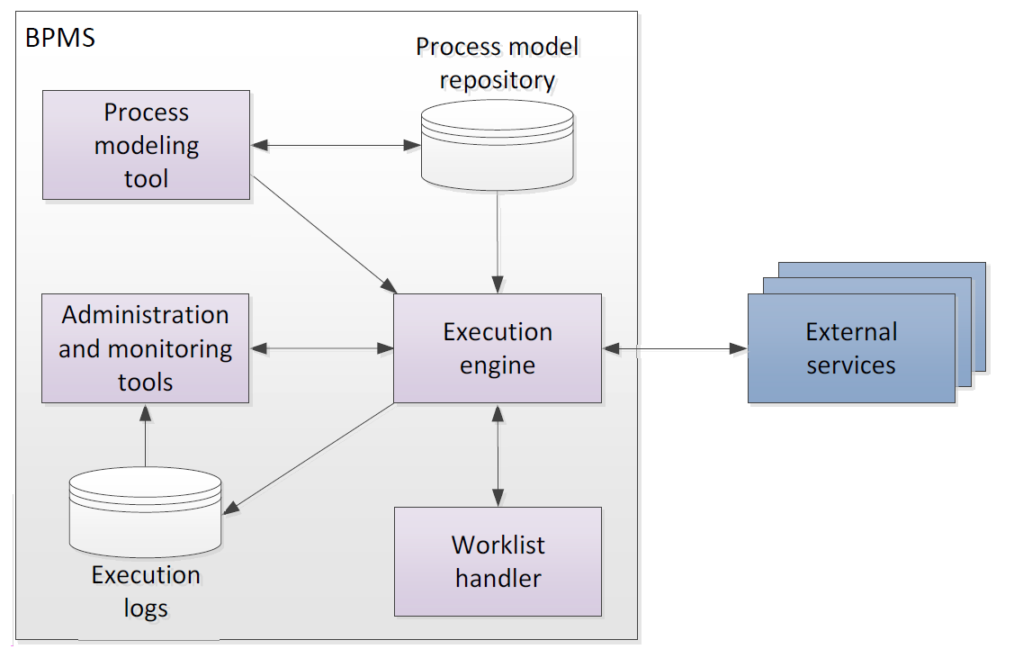
Architecture of a BPMS

Slide 14
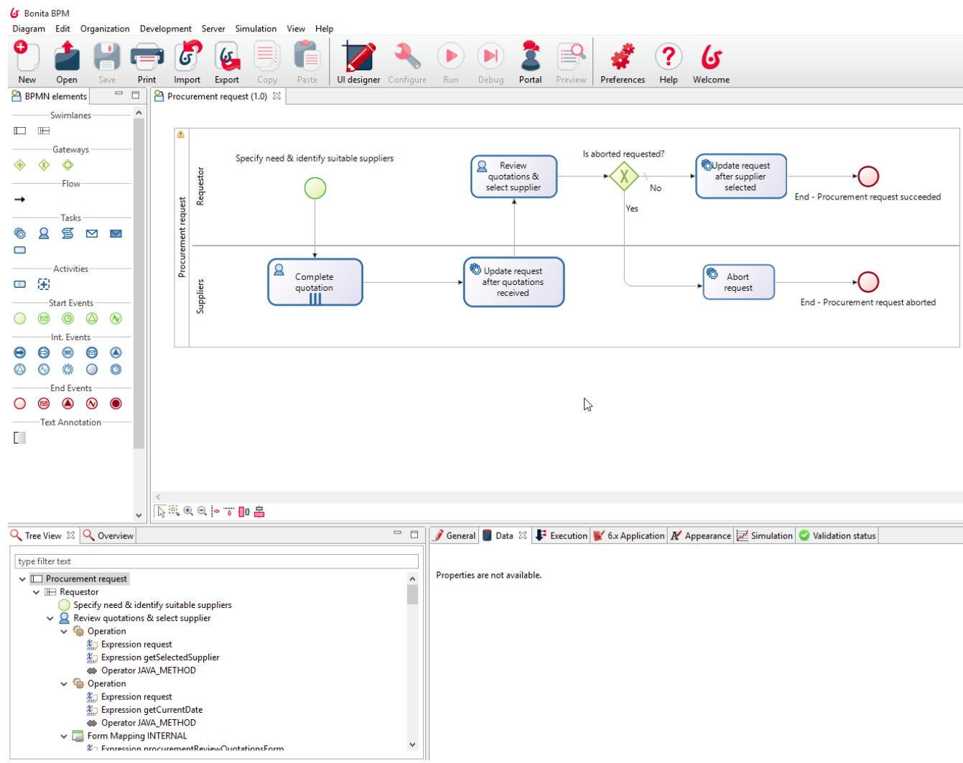
Process Modeling Tool of Bonita

Slide 15
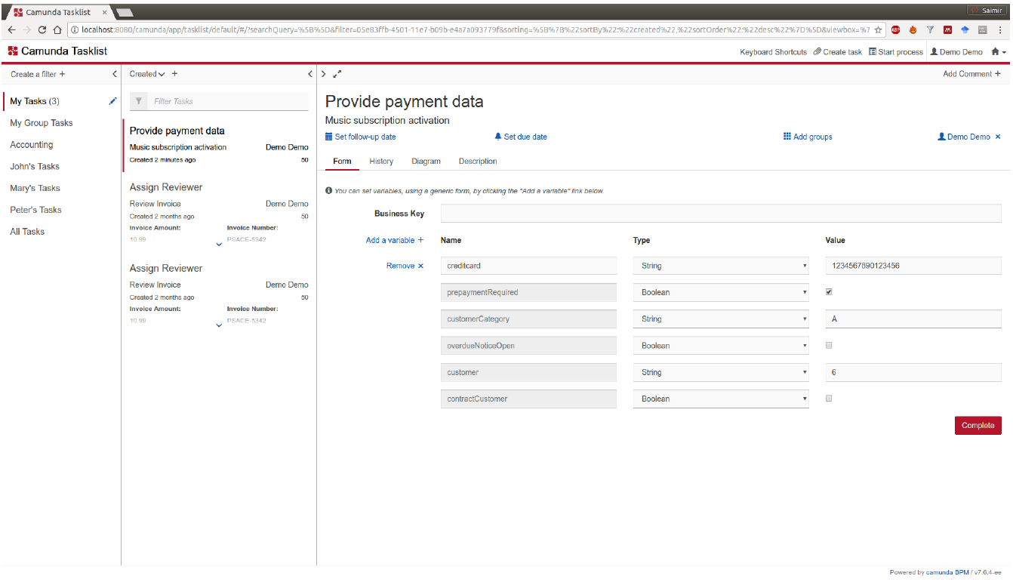
Worklist Handler of Camunda

Slide 16
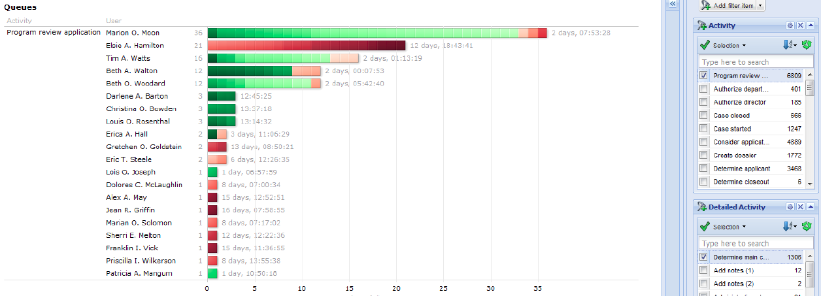
Monitoring Tool of Perceptive

Slide 17
Exercise 9.2: Monitoring Tool of Perceptive
The monitoring of user queues provides good transparency of the current workload of the different process participants. However, any sort of chart should be carefully reflected upon before decisions are made. Before interpreting the above chart, answer the following questions.
1. Which important information is not visible in the chart?
2. Does the chart allow you to conclude who are good and bad employees?

Slide 18

Exercise 9.3: Construction Company BuildIT
Construction Sight of WU Vienna‘s New Campus opened in 2013. Source: Wikimedia Commons

Slide 19
Exercise 9.3: Renting Equipment of BuildIT
Recall BuildIT’s business process for renting equipment from Chapter 1. Let us suppose it is supported by a BPMS.
The execution engine can track that for orders #1,220 and #1,230 site engineers have already filled out the equipment rental requests.
On the basis of a process model of the renting equipment process, the execution engine can detect that for both of these cases the proper piece of equipment must be determined.
This needs to be done by any of the clerks at the depot. Therefore, the BPMS passes on the request to all worklist handlers of all clerks for further processing.
For order #1,240, on the other hand, the equipment rental request is not available yet. So, the BPMS engine will not pass on a similar request for this order yet.
Instead, it will await the completion of this work item.
In which state is the process after all the actions of the rental process of BuildIT have been performed as described above?
Which work items can you identify that are under control of the BPMS?
Make sure to identify both the case and the activity for each work item.

Slide 20
Exercise 9.4: BPMS
Can you imagine that a BPMS can work on the basis of a business process model without any information on the types of resources that are available to work on the tasks? What problems would the BPMS run into when executing this process?
In what situation will the execution engine generate multiple work items after the completion of a single work item?
Can you provide examples of external services that may be useful to be invoked in a loan application process?
If it is important that a BPMS hands out work items to available resources, can you imagine information on resources that is useful to be captured by an administration tool (apart from whether they are ill or on vacation)?

Slide 21
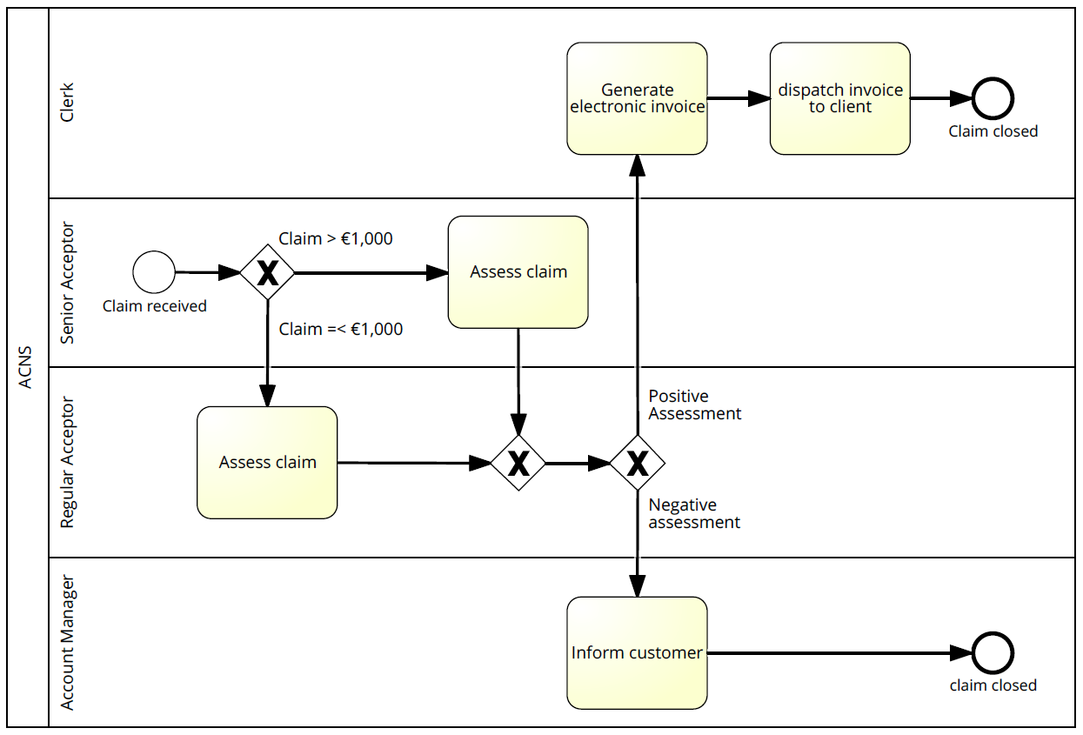
Claims Handling at ANCS
Ms. Senora has been with ACNS for a long time and, for the past years, works as a senior acceptor.
Mr. Regulo has started his training and works as an regular acceptor.

Slide 22
Two new claims are handled
Car damage of € 12,500 claimed by Mr. Bouman
BPMS forwards claim to worklist handler of Ms. Senora.
Positive Assessment.
Work item appears in worklist handler of financial officer to do payment.
Once done, process completes.
A car damage of e 500, as claimed by Mrs. Fillers
BPMS forwards claim to worklist handlers of Ms. Senora and Mr. Regulo.
Mr. Regulo selects the claim, which then disappears from list of Ms. Senora.
Mr. Regulo rejects, case is handed over to account manager.
Client is informed.

Slide 23
Exercise 9.5: ANCS Developments
Consider the following developments and indicate which components of the BPMS architecture are affected:
A new decision support system is developed to support acceptors in making their assessment of claims.
Ms. Senora retires.
A new distinction between claims becomes relevant: regular acceptors are now also qualified to deal with claims above e 1,000 as long as they worked on previous claims by the same client.
Claims that are issued on cars which are over 10 years old need to be continuously monitored by management.

Slide 24
Chapter 9: Process-Aware Information Systems
Contents
Types of Process-Aware Information Systems
Domain-Specific Process-Aware Information Systems
Business Process Management Systems
Architecture of a BPMS
The Case of ACNS
Advantages of Introducing a BPMS
Workload Reduction
Flexible System Integration
Execution Transparency
Rule Enforcement
Challenges of Introducing a BPMS
Technical Challenges
Organizational Challenges
Recap

Slide 25
Advantages of Introducing a BPMS (I)
Workload Reduction
Flexible System Integration
Straight-through processing
Less coordination
Less gathering of relevant information
Generic functionality of process layer
Easier to change process logic
Island automation

Slide 26
Advantages of Introducing a BPMS (II)
Execution Transparency
Rule Enforcement
Transparency of operational information
Transparency of historic information
Reducing freedom of executing process
Enforce separation of duties
Implement control tasks

Slide 27
Exercise 9.6: Advantages of BPMS
To which categories would you classify incentives to introduce a BPMS?
An auditing agency has found out that the written procedures and actual execution of business processes are not aligned. The management of that organization wishes to enforce the written procedures and decides to introduce a BPMS.
The clients of a company complain that they can only get very shallow updates on the progress of the orders they make. The IT manager of that organization looks into the use of a BPMS to capture and provide status information on all these orders.
An insurance organization finds out that there is an urgent need to quickly adjust their claims processing to the offerings that its competitors bring to the market. Using a BPMS is considered to address this demand.

Slide 28
Chapter 9: Process-Aware Information Systems
Contents
Types of Process-Aware Information Systems
Domain-Specific Process-Aware Information Systems
Business Process Management Systems
Architecture of a BPMS
The Case of ACNS
Advantages of Introducing a BPMS
Workload Reduction
Flexible System Integration
Execution Transparency
Rule Enforcement
Challenges of Introducing a BPMS
Technical Challenges
Organizational Challenges
Recap

Slide 29
Challenges of Introducing a BPMS
Technical Challenges
Organizational Challenges
Applications often not developed from a business process perspective
Screen scraping might be required to integrate input and output from legacy
Batch processing systems do not work with a case concept
Middleware, Enterprise Application Integration, Service-oriented Architecture and Web Service solutions support integration
Complexity due to exceptions
Adjust to pace of organizational change
Potential fears of process participants
Strong management commitment needed

Slide 30
Robotic Process Automation (RPA)
Novel class of systems that automate user task on computers
RPA scripts can be developed by recording repetitive user tasks that move data between several computer screens
Robots can then work on task according to these scripts
Software vendors specialized in RPA include, among others:
Automation Anywhere
Blue Prism
PEGA

Slide 31
Change Management
Introducing a BPMS is a larger transformation initiative, often taking dozens of months
Factors that influence the change are DICE:
Duration of initiative,
Integrity of the project team,
Commitment of top management,
Effort demanded from employees
Risk of resistence:
Potential lack of support from employees
Hidden competing commitment
Matters of caution:
Avoid premature victory celebration
Programmatic change fallacy

Slide 32
Exercise 9.7: BPMS at a Hospital
Consider the following issues that come up when introducing a BPMS in a hospital to support preoperative care, i.e., the preparation and management of a patient prior to surgery. Classify them as technical or organizational issues.
On hearing about the plans to introduce a BPMS, the surgeons flatly reject to cooperate on this endeavor. Their claim is that each patient is an individual person that cannot be trusted to the care of a one-size-fits-all system.
The anesthetists in the hospital use a decision support system that monitors the proper dosage of anesthetics to patients. The system is developed as a standalone system that is difficult to synchronize with the BPMS, which has to feed the decision support system with patient data.
The nurses are provided with mobile devices, which they can use to access their worklist handlers. However, they find it difficult to follow up on the automatic notifications, which are signaled to them as gentle vibrations of the device.

Slide 33
Chapter 9: Process-Aware Information Systems
Contents
Types of Process-Aware Information Systems
Domain-Specific Process-Aware Information Systems
Business Process Management Systems
Architecture of a BPMS
The Case of ACNS
Advantages of Introducing a BPMS
Workload Reduction
Flexible System Integration
Execution Transparency
Rule Enforcement
Challenges of Introducing a BPMS
Technical Challenges
Organizational Challenges
Recap

Slide 34
Recap
There are two types of Process-Aware Information Systems (PAIS).
Domain-specific PAIS include
ERP Systems
CRM Systems
SCM Systems
PLM Systems
Business Process Management Systems are domain-agnostic PAIS having:
Execution engine
Process modeling tool
Process model repository
Administration and monitoring tools
Execution logs
Worklist handlers
External services
Advantages of introducing a BPMS:
Workload reduction
Flexible integration
Execution transparency
Rule enforcement
Challenges include:
Technical challenges
Organizational challenges

